Slide 1

Demystifying The Spectral Bias of Overparameterized Deep Neural Networks
Genglin Liu

Slide 2
Outline
- What is NTK
- Part I: Matching ReLU^k activated kernels with generalized Laplacian kernels
- Part II: Spectral properties of multi-layer NTK with multiple activation functions
- Part III: Fitting a multi-scale regression target in NTK regime

Slide 3
Overparametrized Neural Networks
The great success of modern machine learning is largely attributed to the use of deep neural networks.
It has been shown in the limit of infinite neurons, the neural networks behave very similarly to kernel regression with a special kernel called Neural Tangent Kernel (NTK)
Therefore understanding the theoretical properties of NTK (such as its spectral property and learnability) would help us better understand the convergence and generalization error of neural networks in the overparameterization regime
Investigating the reproducing kernel Hilbert space (RKHS) associated to the NTK.
Studying the RKHS → Compute the spectral decay of the kernel

Slide 4
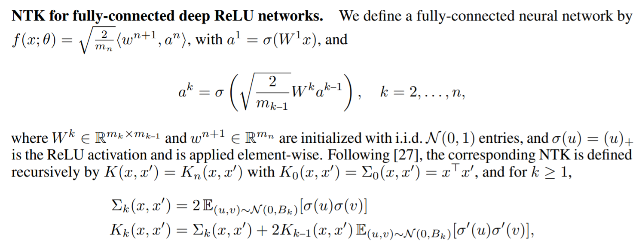
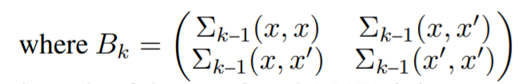
Recursive Definition of Neural Tangent Kernel

Slide 5
NTK Theory
MLPs have difficulty learning high frequency functions, a phenomenon referred to in the literature as "spectral bias“
NTK theory suggests that this is because standard coordinate-based MLPs correspond to kernels with a rapid frequency falloff, which effectively prevents them from being able to represent the high-frequency components in functions and content present in natural images and scenes (Tancik et al.)
The outputs of a network throughout gradient descent remain close to those of a linear dynamical system whose convergence rate is governed by the eigenvalues of the NTK matrix. Analysis of the NTK’s eigen-decomposition shows that its eigenvalue spectrum decays rapidly as a function of frequency, which explains the widely-observed "spectral bias" of deep networks towards learning low-frequency functions.

Slide 6
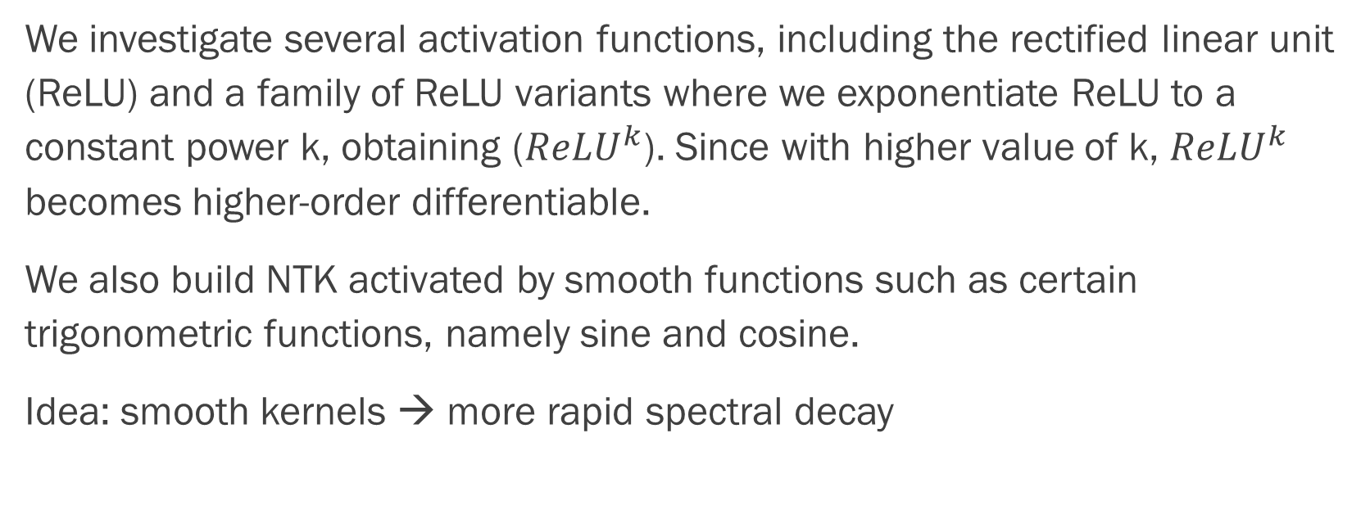
Activation Functions and Smoothness
We investigate several activation functions, including the rectified linear unit (ReLU) and a family of ReLU variants where we exponentiate ReLU to a constant power k, obtaining (${ReLU}^{k}$). Since with higher value of k, ${ReLU}^{k}$ becomes higher-order differentiable.
We also build NTK activated by smooth functions such as certain trigonometric functions, namely sine and cosine.
Idea: smooth kernels → more rapid spectral decay

Slide 7
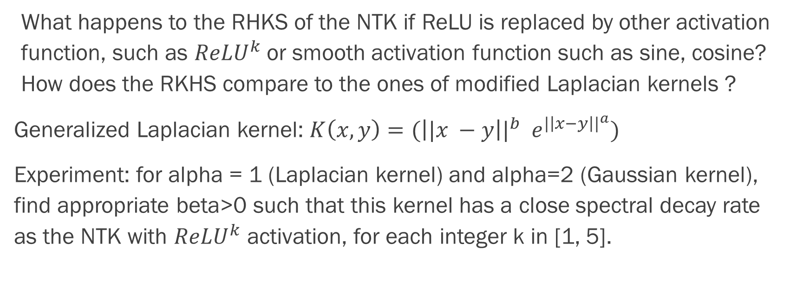
Part 1: Spectral Properties of Two-layer NTK
What happens to the RHKS of the NTK if ReLU is replaced by other activation function, such as ${ReLU}^{k}$or smooth activation function such as sine, cosine? How does the RKHS compare to the ones of modified Laplacian kernels ?
Generalized Laplacian kernel: $K\left(x, y\right)=({\left||x −y\right||}^{b} e^{{|\left|x−y\right||}^{a}})$
Experiment: for alpha = 1 (Laplacian kernel) and alpha=2 (Gaussian kernel), find appropriate beta>0 such that this kernel has a close spectral decay rate as the NTK with ${ReLU}^{k}$ activation, for each integer k in [1, 5].

Slide 8
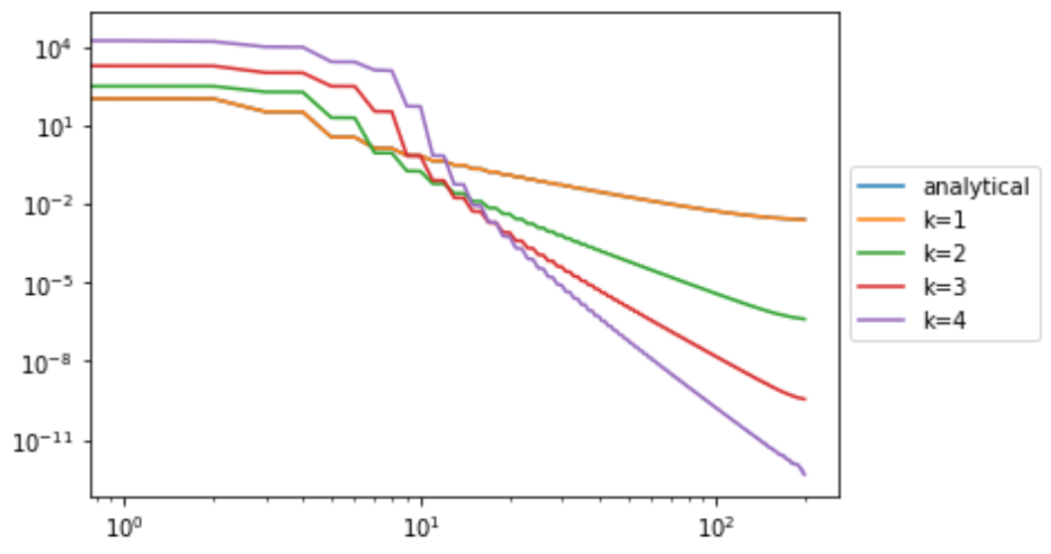
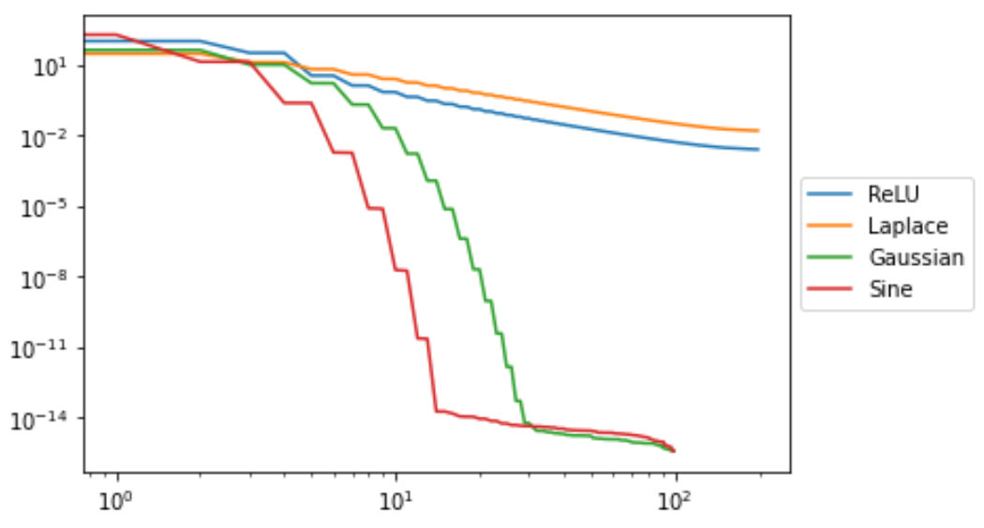
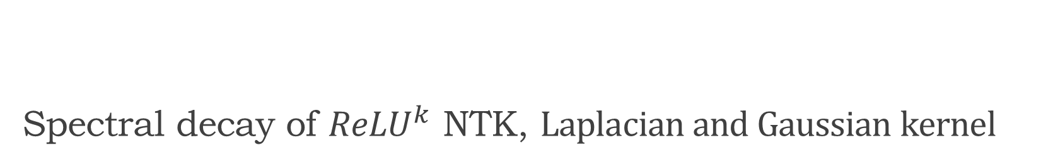
Spectral decay of ${ReLU}^{k}$ NTK, $Laplacian and Gaussian kernel$

Slide 9
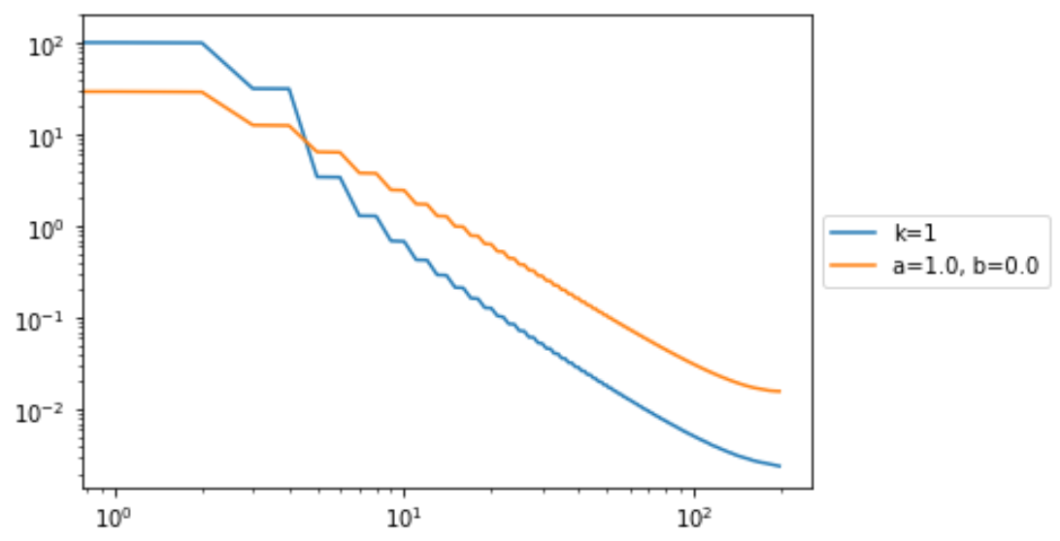
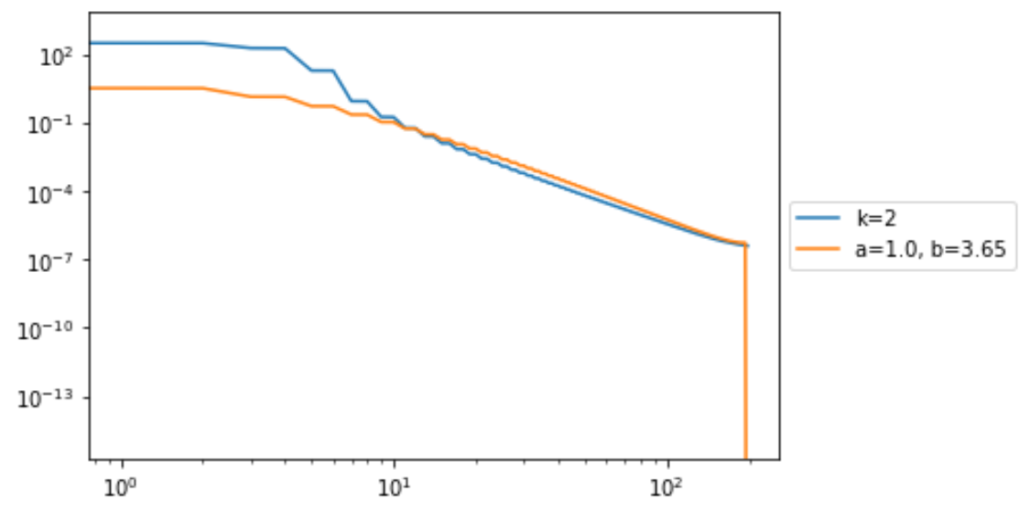
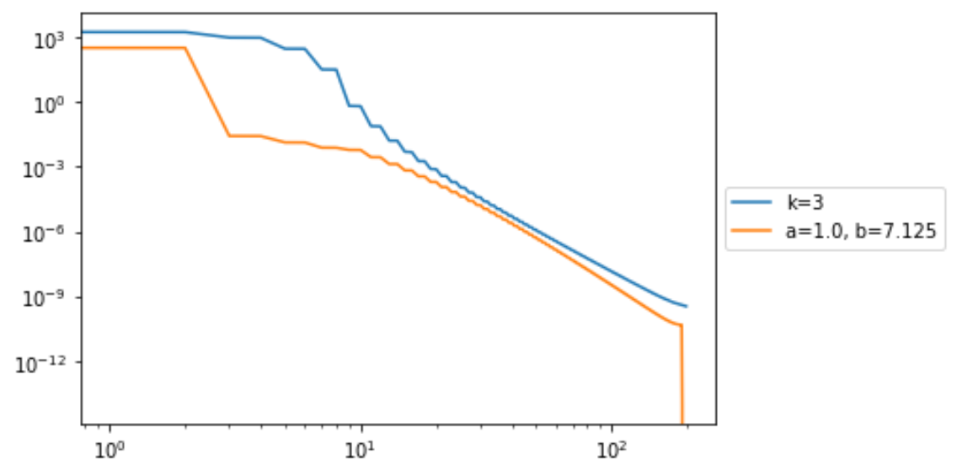
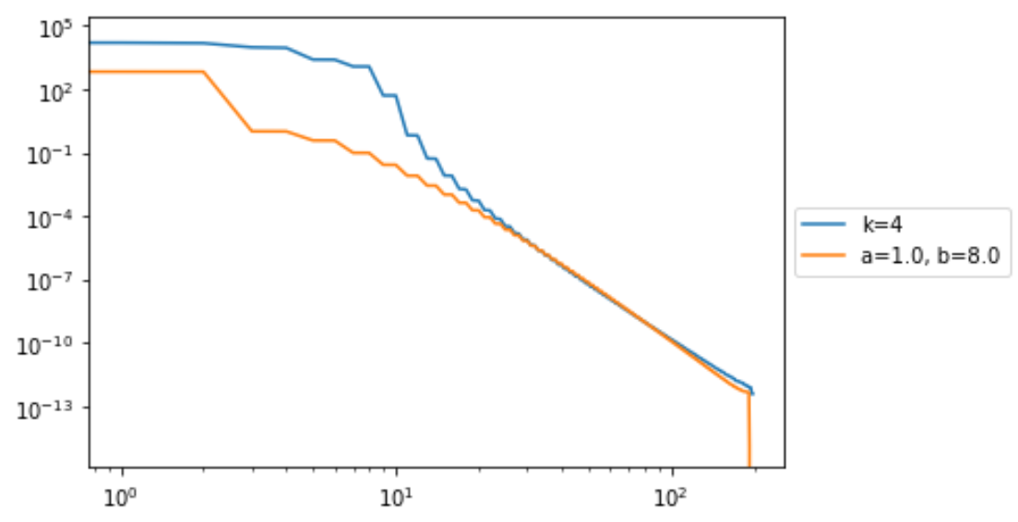

Slide 10
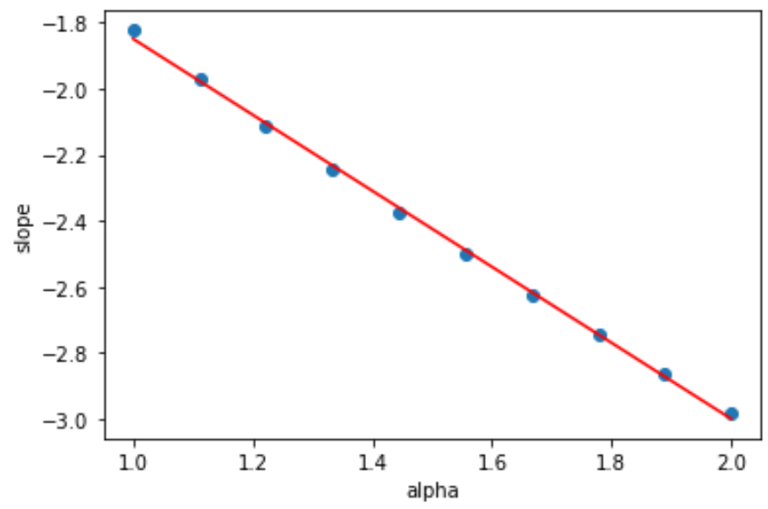
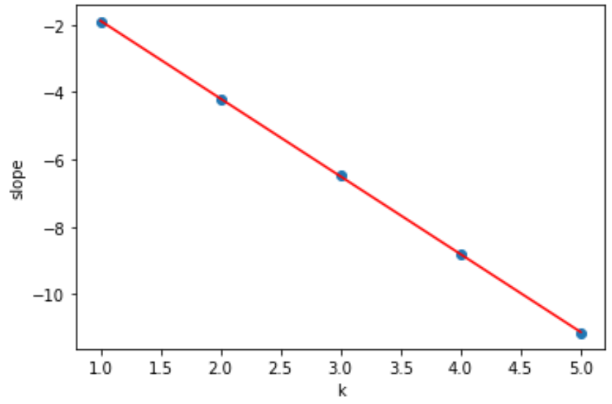
Linear relationship between alpha, k and decay rate, without beta

Slide 11
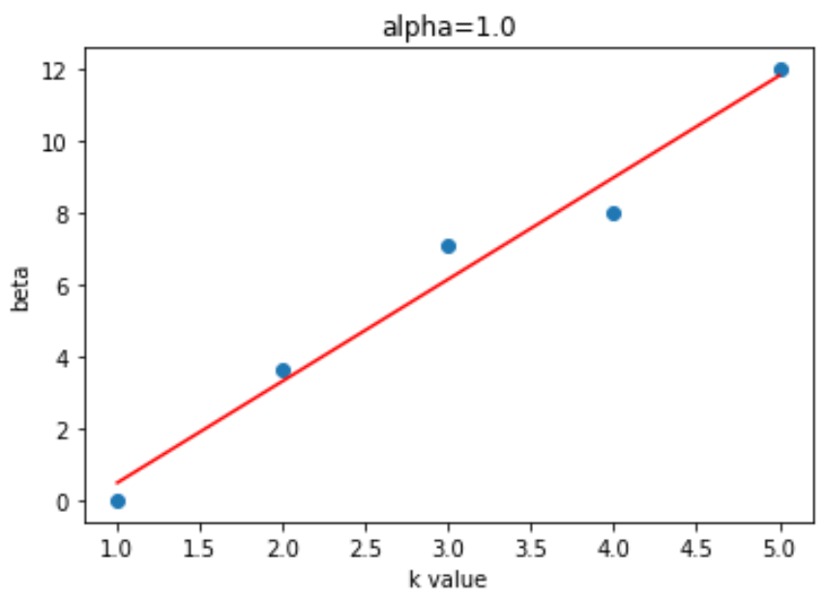
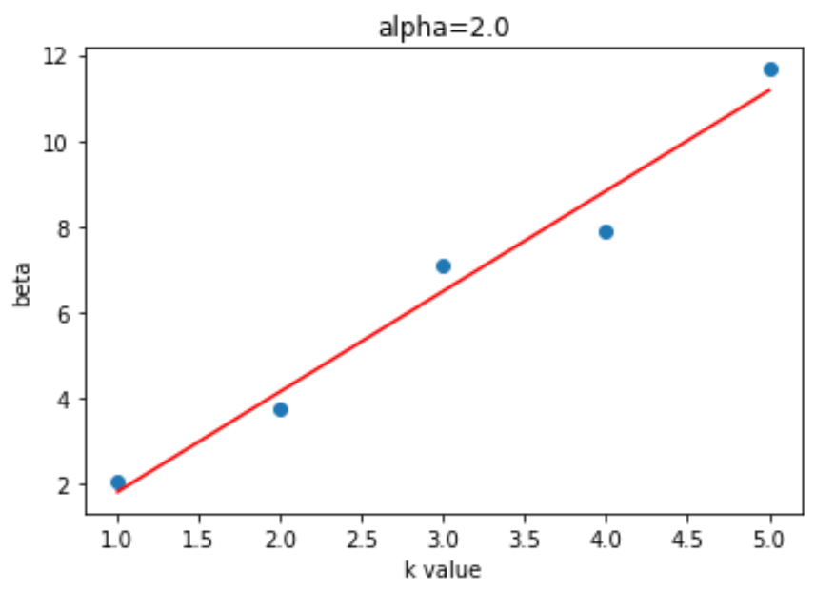
Linear relationship between beta vs k value, given fixed alpha

Slide 12
Part 2: Multi-layer NTK
Deep neural network with multiple activation functions can sometimes achieve much better approximation power than the ones with a single activation. Can we show that the spectral bias of NTK can be alleviated if one uses multiple activation functions?

Slide 13
Building the Multi-layer NTK
To verify our idea, we had to extend our kernel construction from two layers to three layers, i.e., now we have an input layer and two hidden layers in our model. Because the sampling is now multivariate instead of the previous case, we had to build a new model from scratch to keep the computation coherent.
Similar to the two-layer case, we have an analytical solution for the ReLU network, as well as numerical approximation to a network with a general nonlinear activation, with both an entry-wise version and a vectorized version.

Slide 14
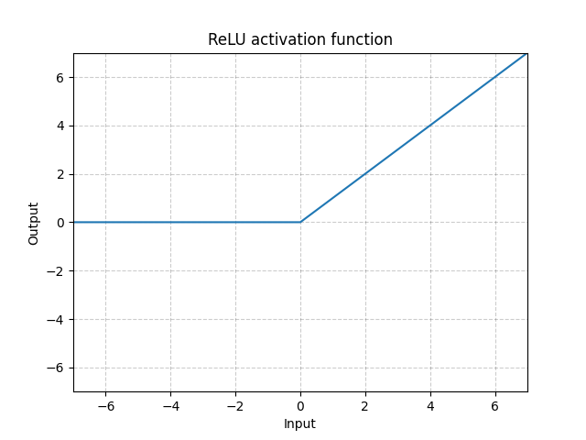
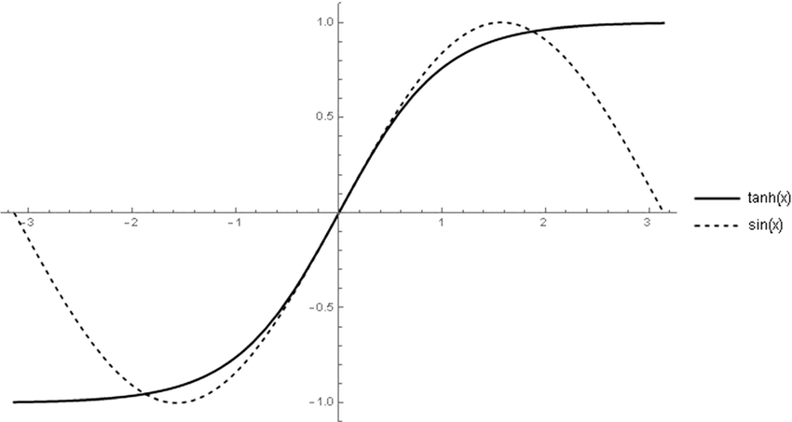
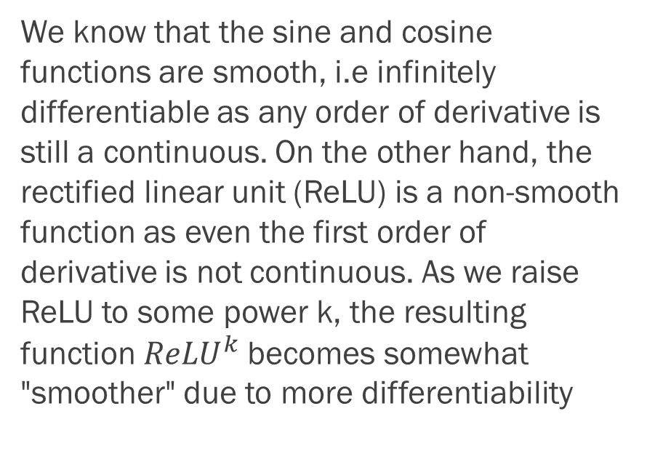
Smoothness of Activation Function
We know that the sine and cosine functions are smooth, i.e infinitely differentiable as any order of derivative is still a continuous. On the other hand, the rectified linear unit (ReLU) is a non-smooth function as even the first order of derivative is not continuous. As we raise ReLU to some power k, the resulting function ${ReLU}^{k}$becomes somewhat "smoother" due to more differentiability

Slide 15
Kernel Smoothness and Spectral Decay
We have known facts about the relationship between the smoothness of the kernel function and their RKHS. As observed in our 2-layer NTKs, smoother kernels (Gaussian kernel and sine/cosine-activated NTK) have a much steeper spectral decay (exponential as we observed) whereas the other non-smooth kernels such as Laplacian and ReLU-activated NTK have a slower eigenvalue decay, linear under the log-log scale.
For the multi-layer NTK with different activation functions, our initial speculation was that the smoothness of the kernel is governed by whatever activation function that comes first, i.e. if we have a sine activation function on the first hidden layer and ReLU on the second, then the kernel would exhibit a faster spectral decay rate than the one if we switched the order of the activation functions. However, our numerical experiments tells otherwise.

Slide 16
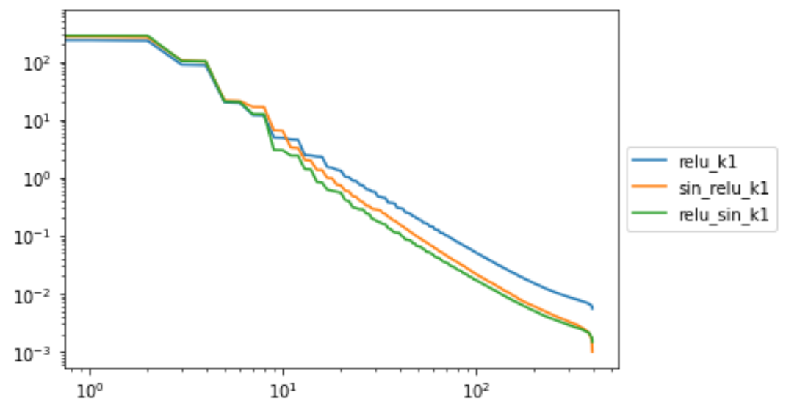
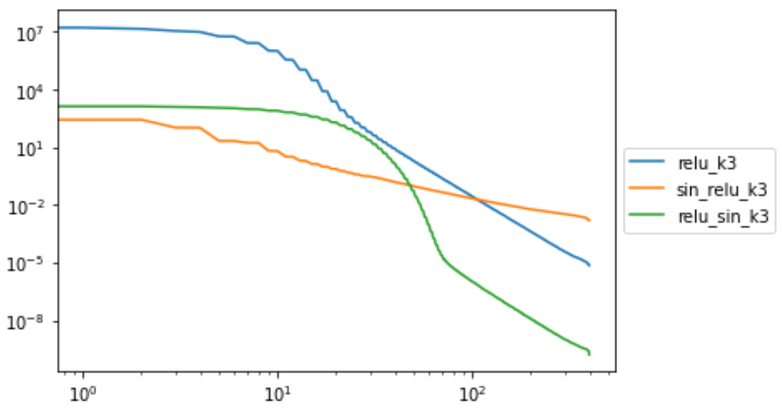
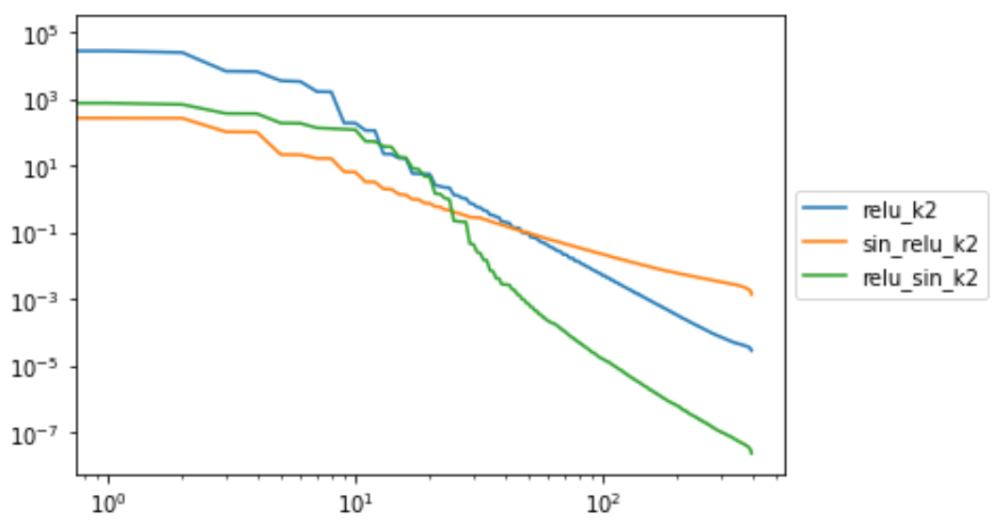
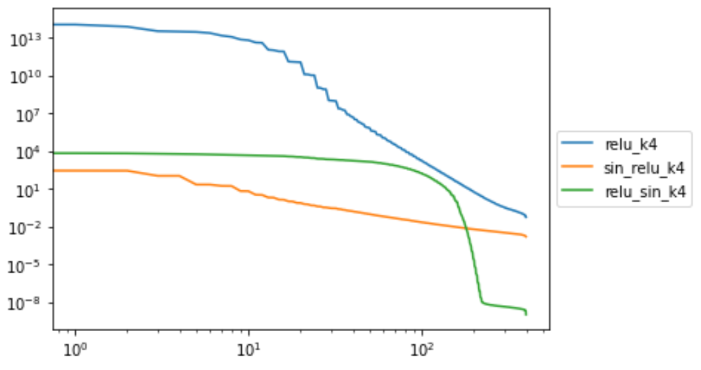

Slide 18
Part III: Training in NTK regime
Consider the regression problem of fitting a target function containing multiple frequencies using neural networks. Due to the spectral bias, the high frequency mode is much difficult to learn compared to the lower modes.
What can we observe from training under the standard weight initialization vs training under in the neural tangent kernel regime?

Slide 19
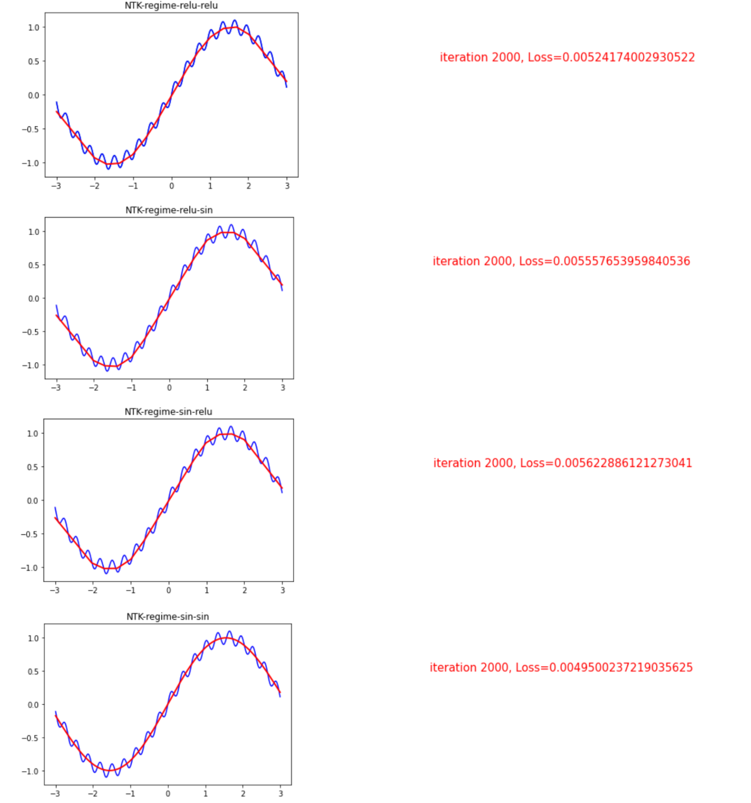
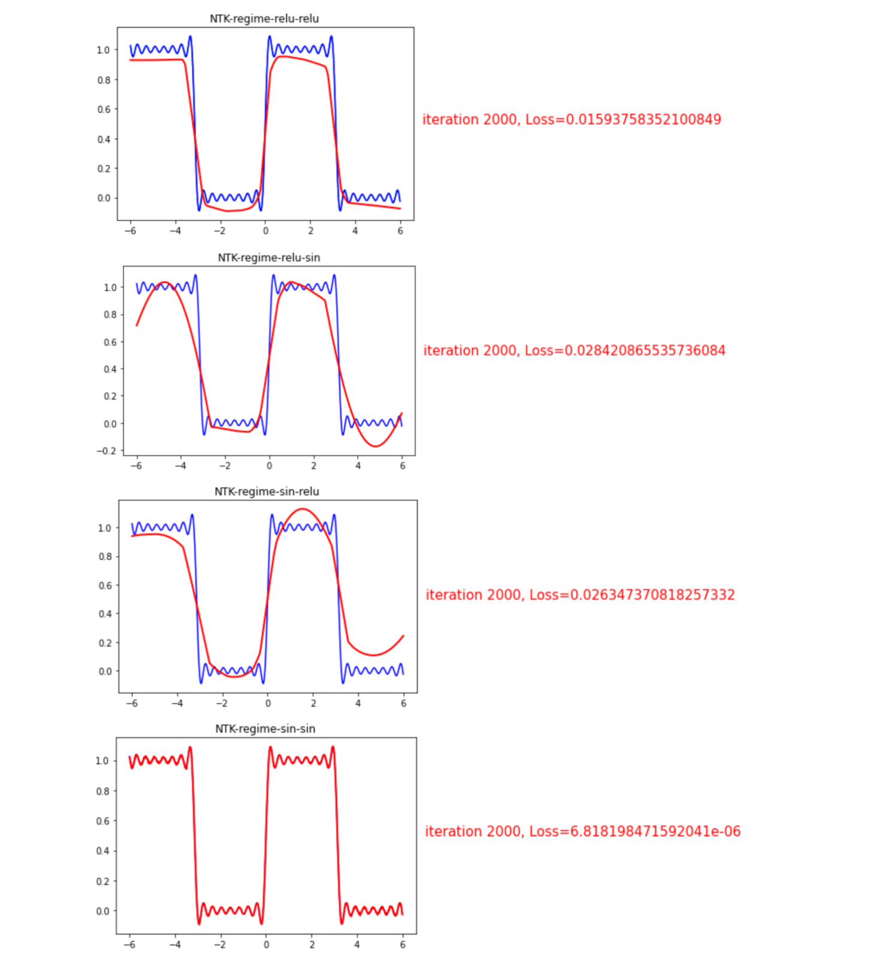

Slide 20
